Slide 1



TECNOLOGICAL SOLUTION FOR SAFE DISPOSAL OF MENSTRUAL WASTE
by
THE TERM TRIBE

Slide 2
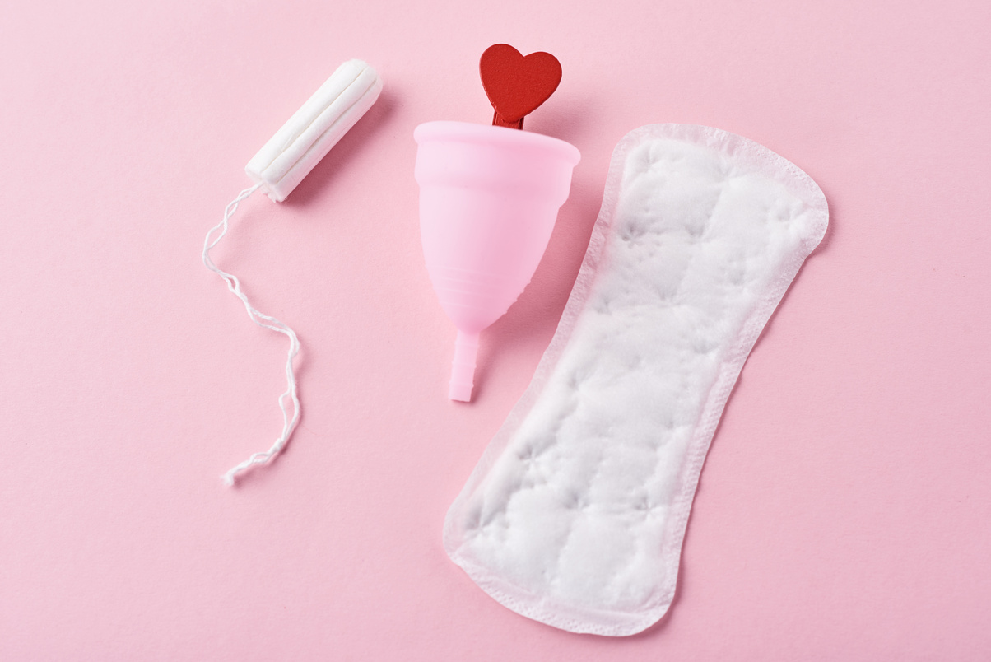
WHAT IS PAD..........?
Sanitary pad, which is also known as sanitary napkin or menstrual pad, is a thin pad made of absorbent material that absorbs the menstrual fluid during menstruation. Some sanitary pads are disposable and are meant for single use only. Most sanitary pads available in the market are disposable ones. Reusable sanitary pads are mostly cloth pads that can be washed, dried and reused over a number of times.
Sanitary pads come in different shapes and sizes, with different capacity to absorb for days of heavy and light menstrual bleeding. You will have to experiment with different kinds of sanitary pads to know which one best suits your needs.

Slide 3
Raw Material of Sanitary Napkin / Pads
48% of fluff pulp; 36% PE, PP, and PET; 7% adhesives; 6% superabsorbent; and 3% release paper.
Materials used in absorbent hygiene products:
Pulp
Super absorbent
Plastic film
Elastic materials
Fastening devices
Packaging
However, when large amounts of liquid need to acquired and distributed, none of the structures seems to function well enough to justify the incremental cost.

Slide 4


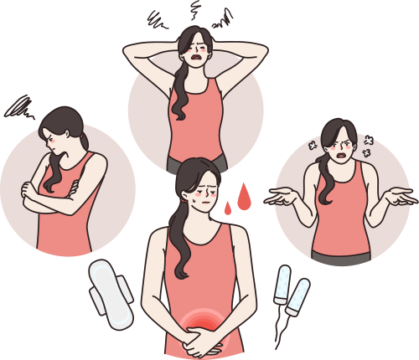
What Is Menstruation ?
The egg travels through a thin tube called a fallopian tube to the uterus. If the egg is fertilized by a sperm cell, it attaches to the wall of the uterus, where over time it develops into a baby. If the egg is not fertilized, the uterus lining breaks down and bleeds, causing a period.
Periods can last anything between 4 and 8 days, but usually last for about 5 days. The bleeding tends to be heaviest in the first 2 days – but everyone is different. When your period is at its heaviest, the blood will be red. On lighter days, it may be pink, brown or black.

Slide 5
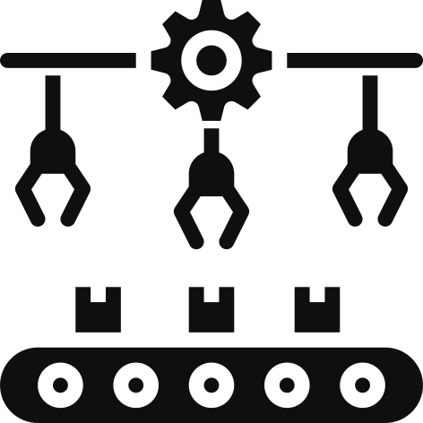

Production Process
Flow Chart of Sanitary Napkin
Pulp
↓
Grinding
↓
Mat formation
↓
Tissue spread (up layer, lower layer)
↓
Mat section
↓
Wrap P.E.Film
↓
Hot-melt seal embossing
↓
Applying hot melt adhesive
↓
Release belt
↓
Finished products section
↓
Finished products arranged in parallel (sanitary napkin)

Slide 6
HEALTH RELATED PROBLEMS OF USING PADS
It's critical to realise that exposure to these substances in excess may increase the risk of developing breast and ovarian cancer. By interfering with female hormones like oestrogen, they may eventually cause problems including irregular menstruation.
Some of these plastic materials have the potential to emit toxins like phthalates and volatile organic compounds (VOCs), which are absorbed via the delicate vaginal skin and mucosa.
over the past several years there has been concern over exposure to dioxins using tampons and other sanitary products. Several ongoing investigations have examined the relationship between the usage of sanitary products that absorb substances like dioxin and super-absorbent polymers and the prevalence of genital cancer.
Dioxin may collect in the body and affect women’s reproductive organs, which can result in cervical cancer or ovarian cancer. It is basically a carcinogen, which means it encourages the creation of cancer-causing cells in your body.

Slide 7

Is Their Any Effect On Environment ?
According to a study conducted by Toxics Link in India (2019), found that the average sanitary pad contains the equivalent of four plastic bags, and it takes around 500–800 years for a sanitary pad to decompose.
Furthermore, a report by the Menstrual Health Alliance India (MHAI, 2018) revealed that 121 million Indian women use disposable sanitary napkins, collectively generating over 113,000 tonnes of menstrual waste annually.

Slide 8

WASTE PRODUCTION ANALYSIS...?
Periods can last anything between 4 and 8 days, but usually last for about 5 days. The bleeding tends to be heaviest in the first 2 days – but everyone is different. When your period is at its heaviest, the blood will be red. On lighter days, it may be pink, brown or black.
Menstrual disorders are problems that affect a woman's normal menstrual cycle. They include painful cramps during menstruation, abnormally heavy bleeding, or not having any bleeding.
Menstruation occurs during the years between puberty and menopause. Menstruation, also called "menses" or a "period," is the monthly flow of blood from the uterus through the cervix and out through the vagina.

Slide 9
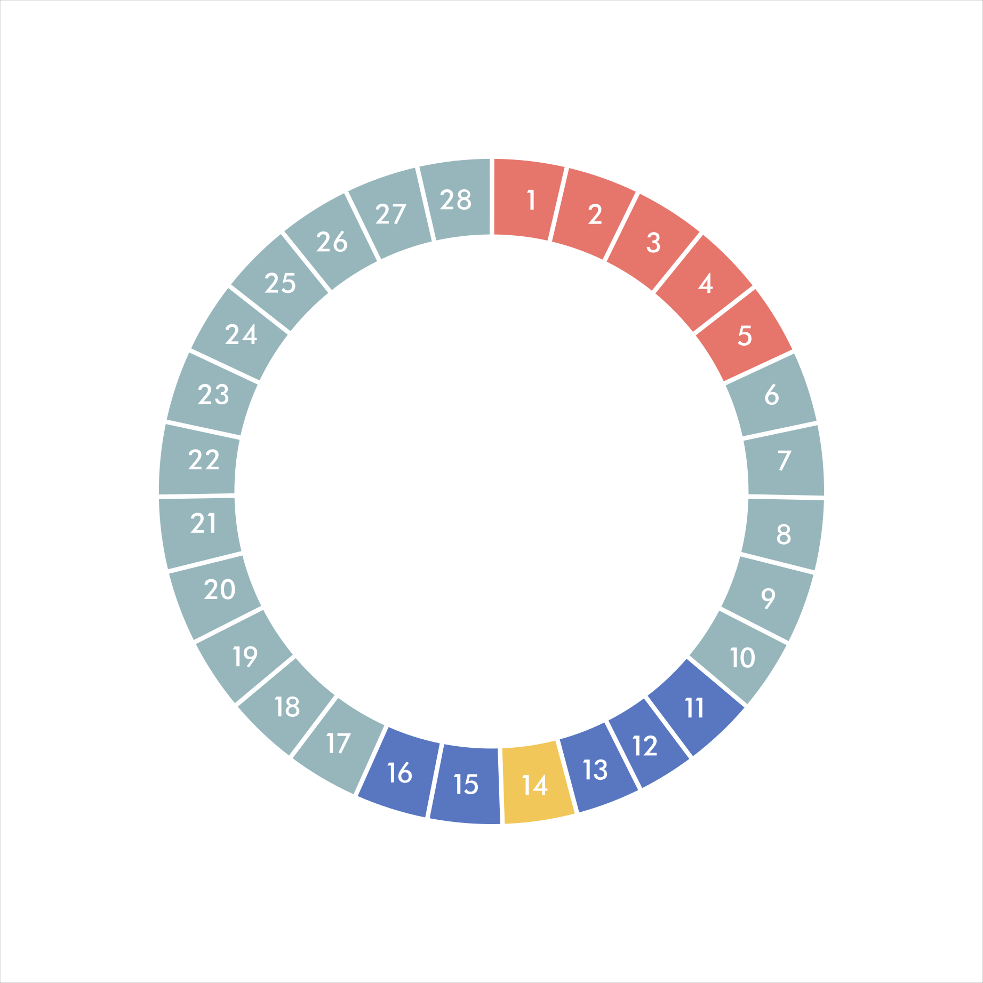
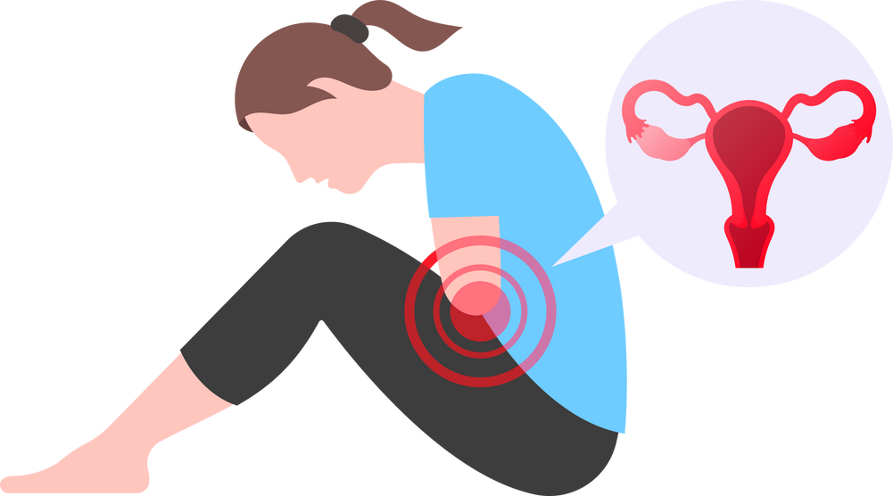

Menstrual Disorders
Menstrual disorders are problems that affect a woman's normal menstrual cycle. They include painful cramps during menstruation, abnormally heavy bleeding, or not having any bleeding.
Dysmenorrhea (Painful Cramps)
Dysmenorrhea is severe, frequent cramping during menstruation
Menorrhagia (Heavy Bleeding)
Amenorrhea (Absence of Menstruation)
Oligomenorrhea (Infrequent Menstruation)
Hypomenorrhea (Light Menstruation)
Premenstrual Syndrome (PMS)

Slide 10
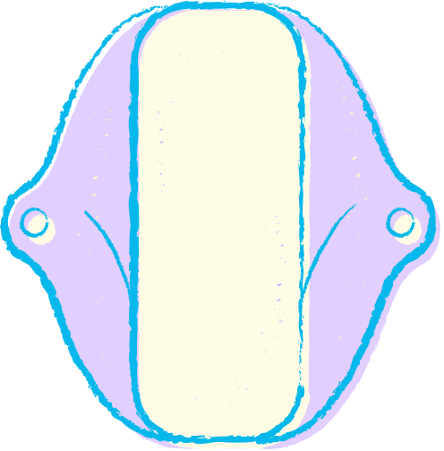


Women Menstruation and Period Poverty
In India
Around 50% of women in India still use menstrual cloth during their periods. Only around 1.7% of women use products like tampons. Also, the use of sanitary napkins is directly proportional to the income level of families. In the poorest families, only around 53% of women use hygienic menstrual products..
71% of girls in India are not aware of women period cycle or menstruation before their first periods. Many people in rural India don’t practise proper menstruation hygiene.
Things are challenging since there is a lack of proper restrooms, menstrual products, and water. 15000 of the 10.83 lakh government schools in the nation do not have restrooms, according to official statistics. The problem for so many teenage menstruators worsens by the conspicuous lack of sanitary facilities.

Slide 11
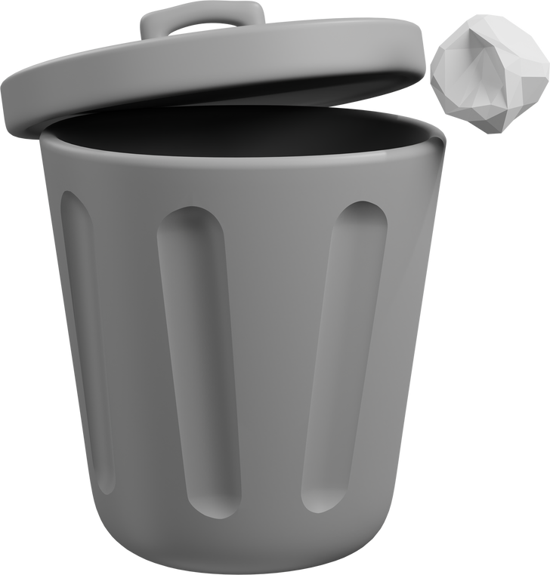

Existing System Of Disposal
Improper disposal of the sanitary pad can lead to various problems which include large heaps of pads all over, bacteria causing infection, unhygienic environment etc. The used sanitary pad that have not been disposed of properly sometimes block the drainage system.
Incineration is a better technique to dispose of menstrual waste but burning of used pads releases harmful gases that effects health and environment. At home, women generally throw pads openly which leaves the place exposed to mosquitoes for their breeding.
This spreads bacteria and infection. They usually throw the pads along with the home waste because they fear from being known that they use a sanitary pad. At school, due to lack of sanitary facilities, girls throw their pads in the toilets. Since there are no dustbins, they leave the soiled pads wrapped or unwrapped in the toilet corners.
This makes the toilet dirty and filthy. Whether at home or at public places, women have the habit of disposing of their used pads by flushing them and this leads to the blockage of the sewage system

Slide 12
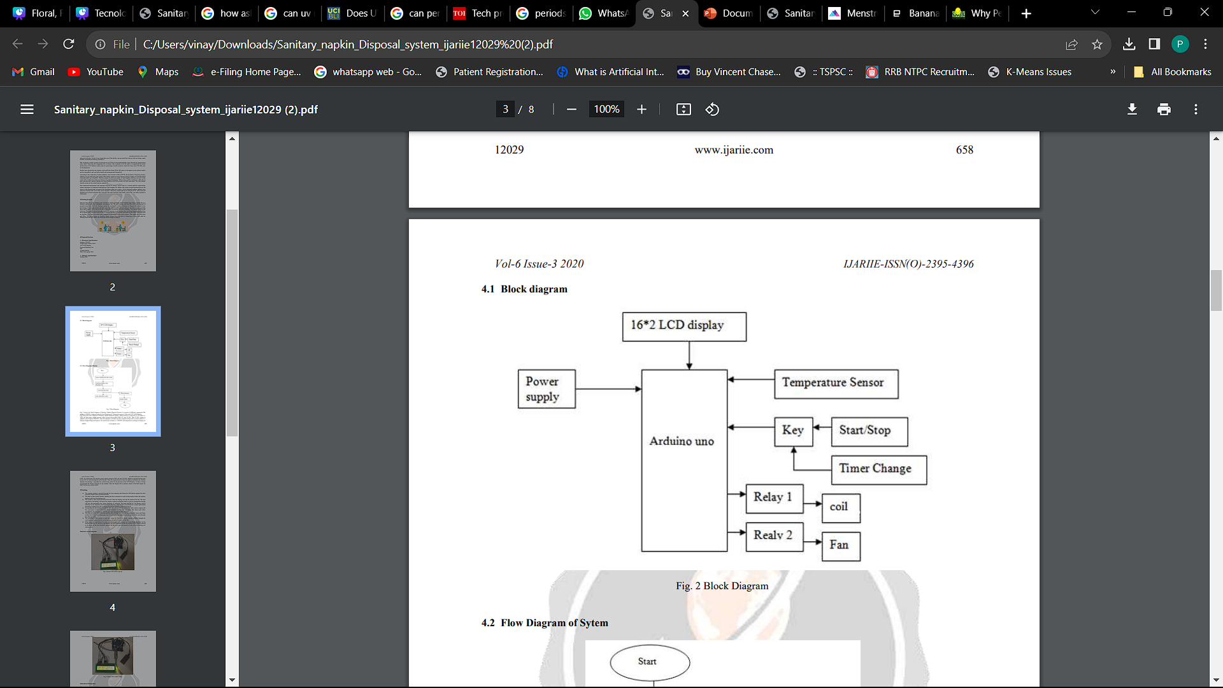
Block Diagram Of Disposal System
The block diagram of Sanitary Napkin Disposal System. It consists of different component like
Arduino UNO R3, 4 channel relay for fan, Heating coil, Temperature sensor, Filter and 16*2 LCD Display.
When system is connected to AC mains i.e.230V AC the power supply present in the system convert that 230V AC into 5V DC. This 5V DC voltage is
applied to the Arduino UNO R3.
Once the program is loaded into the computer along with a system name i.e.”
Sanitary Napkin Disposal System”, the initial state of timer i.e. ON/OFF and temperature reading are
Display on LCD. As system turn ON, another power supply converts 230V AC into 12V DC which is required for the relay to turn ON,
Its starts heating the coil of burner. Once the required heat to burn the napkin is attained, the Arduino displays the message regarding the system being ready for its process on the LCD Display. A timer is being programmed for 5min to dispose of one napkin. After the dispose ash is produce which is the final output we want. In this way system works.

Slide 13
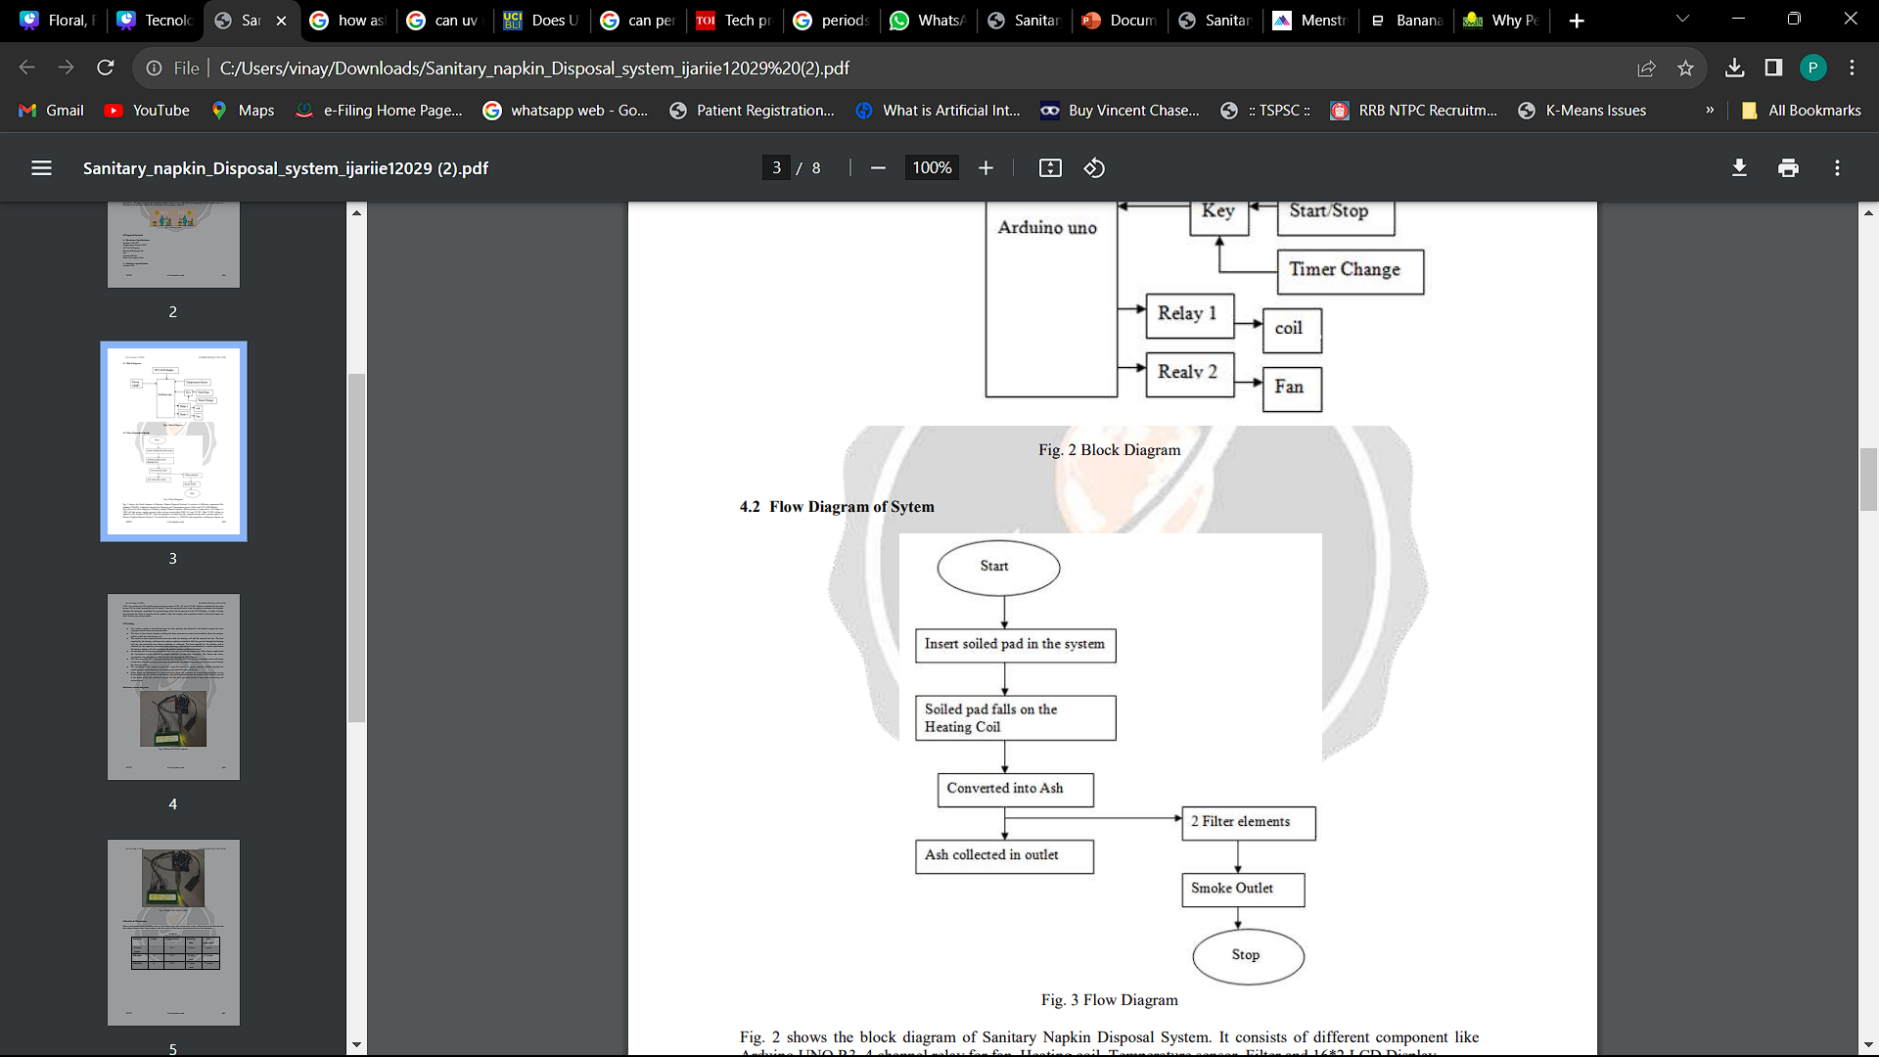
Flow Chart Of Disposal System

Slide 14
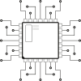
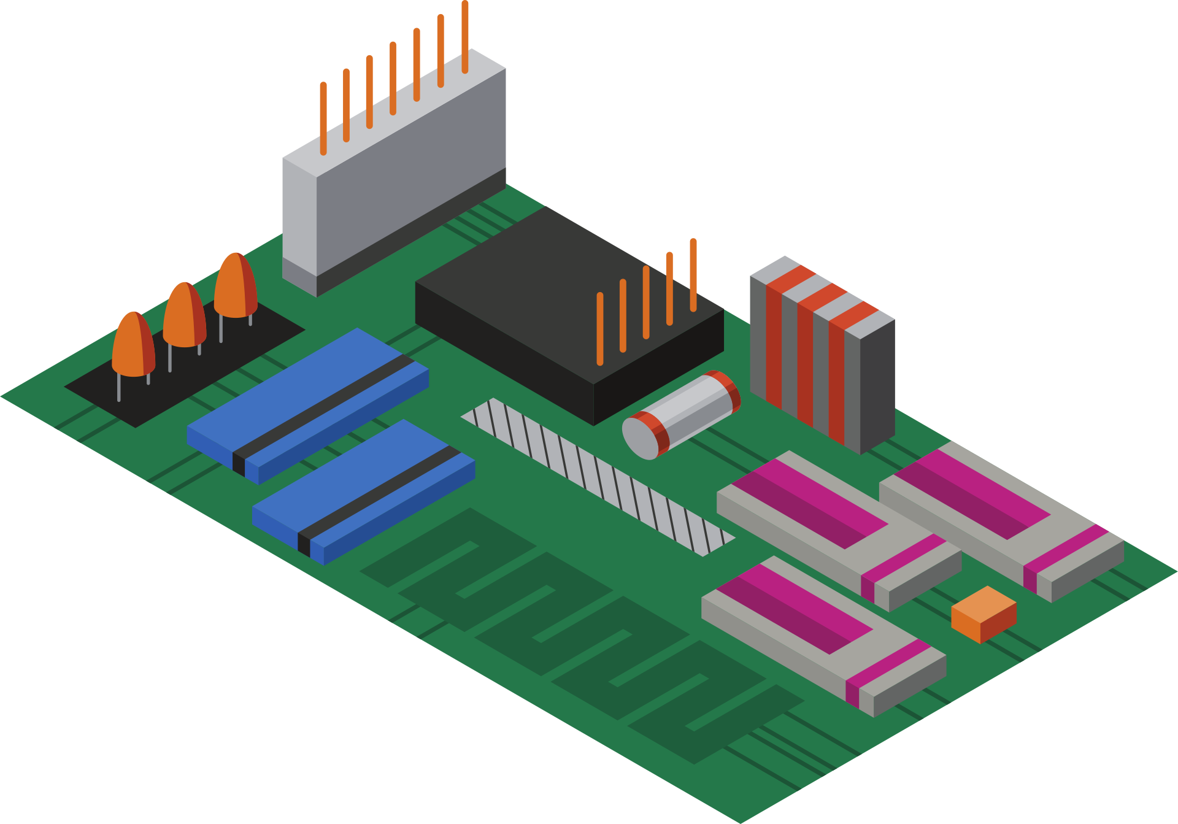

WORKING PRINCIPLE OF
SANITERY NAPKINS
The sanitary napkin is inserted through the door opening and allowed to fall andrest against the door extension which closes the material inlet.
The door is then closed, thereby enabling the door extension to rotate downwardly to allow the sanitary napkin to fall onto the heating coil. •
The switch is then depressed which activates both the heating coil and the motorof the fan. The heat supplied by the heating coil burns the sanitary napkin to ashwhich falls, by gravity, through the heating coil into the removable tray where the debris is collected. The heat supplied by the heating coil is reflected by the angularly positioned heat reflecting surfaces and concentrated at a central point within the heating chamber. By this technique the sanitary napkin is efficiently burned.
Air passing into the housing through air inlet also aids in both the combustion ofthe sanitary napkin and the conveyance of the undesirable fumes andodors to the filter assembly. The fumes and odors, circulated by the incoming air, thereby pass only through the filter element. •
The filter assembly filters the gases passing there through and removes anyundesirable odors and fumes so that only filtered and clean gases may be returnedto the immediate environment of the room through the clean gas outlet.

Slide 15
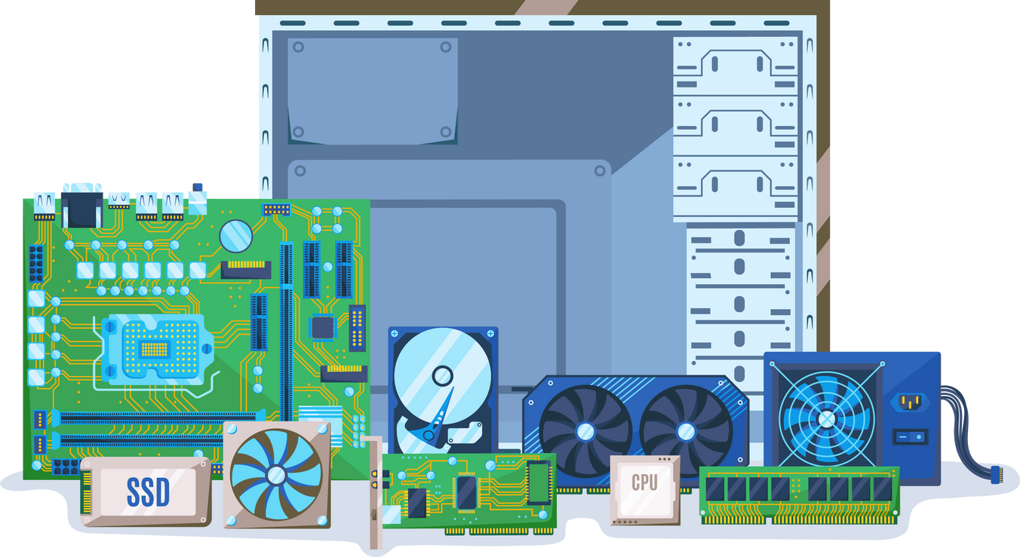
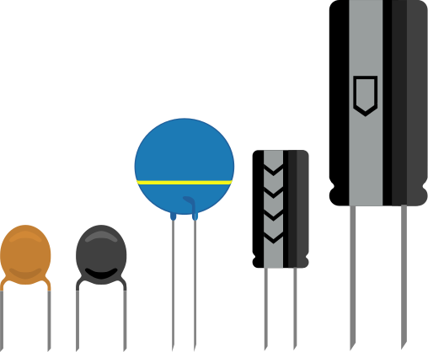
The operation of the circuit is such that, when the Switch is closed, current willflow through the switching mechanism directly to the heating coil and to themotor of the fan. •
Either upon the expiration of a time interval or upon the presence of a specifiedtemperature in the heating chamber, the current to the heating coil will beterminated and the current will be directly passed to the motor of the fan whichwill operate the fan for a specified period of time after the heating coil isdeactivated.

Slide 16
Result & Output
This system gives a solution for destroying napkin waste in a very hygienic way. ➢
On the Industrial level, incineration process requires very high temperature ranging from 800°C - 1000°C.
As our project is being implemented on the educational level, there were some limitations we had to follow for safety purpose. Our system operates at a max temperature of 120° C and it generates some amount of smoke.
Whereas if implemented at the industrial level with very high temperatures, it will reduce the burning time and generate very low smoke.

Slide 17
THANK YOU
K.Bhavani
K.Satya Sai
K.Akshit
K.Murali
R.Vinitha
S.Manasa

